Slide 1
Installation of Talend Remote Engine on Windows Server
Step 1:- Install and Setup java on Windows server.
Step 2:- install the java from
https://www.oracle.com/in/java/technologies/javase/jdk11-archive-downloads.html
Download .exe file
Step 3:- Run the .exe file as Run as Administrator
Step 4:- Setup the path of Java file
Step 5:- Goto the Environment Variables.
Click new and add the JAVA_HOME path
Add the path in system varibles.
Step 6:- Reboot the System
Step 7:- Check the java version in CMD
java -version

Slide 2
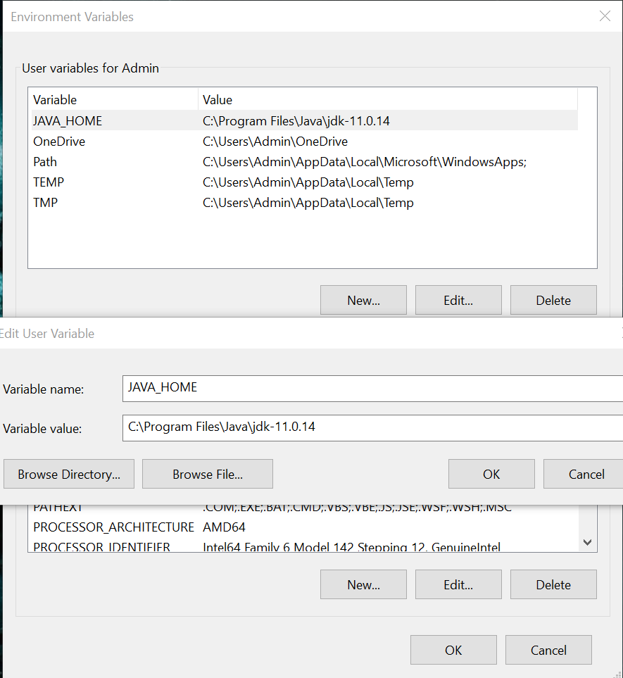

Slide 3
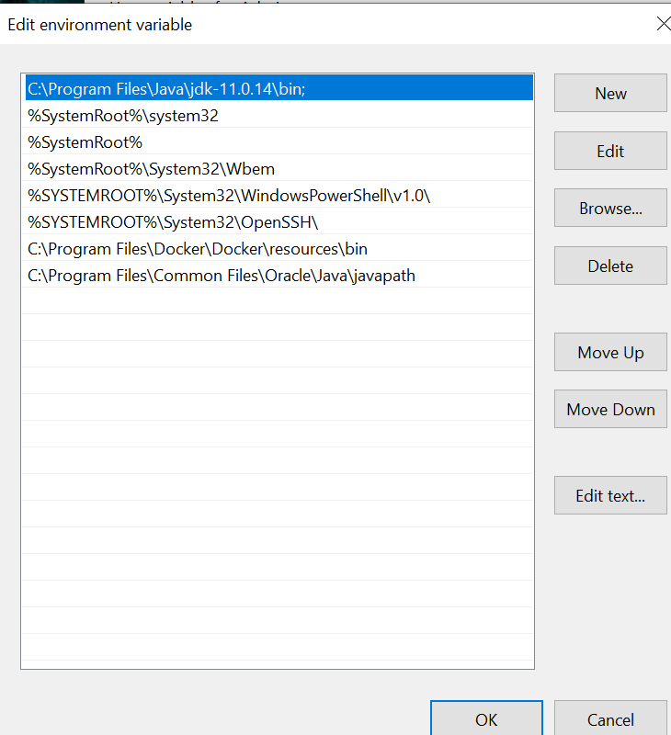

Slide 4
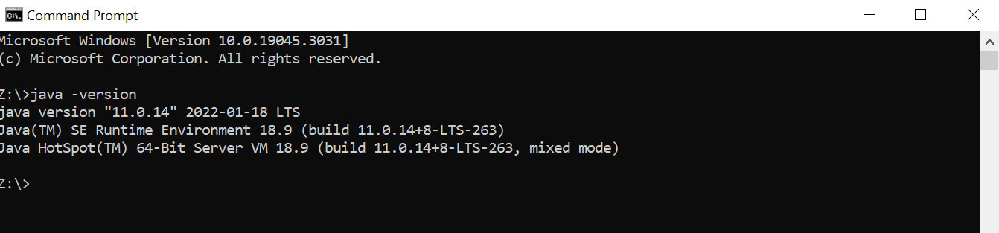

Slide 5
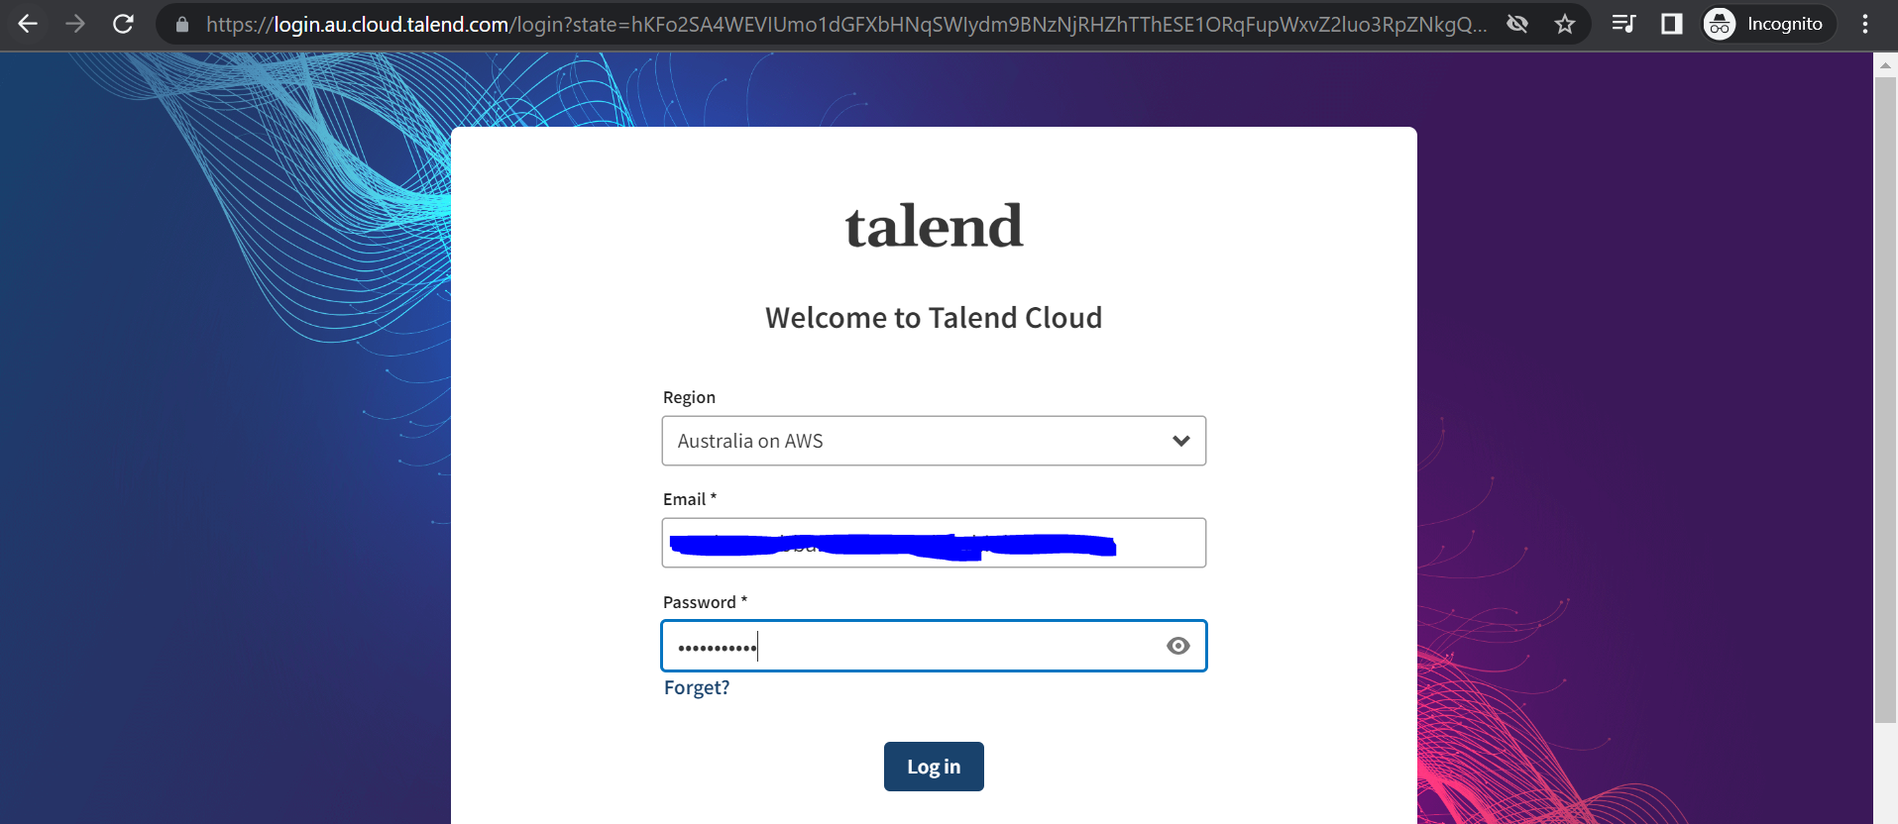
Step 7:- Login into the Talend Cloud Account
Step 8:- Goto the Downloads.

Slide 6
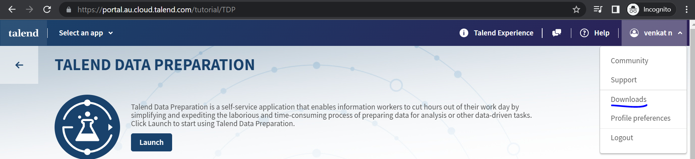
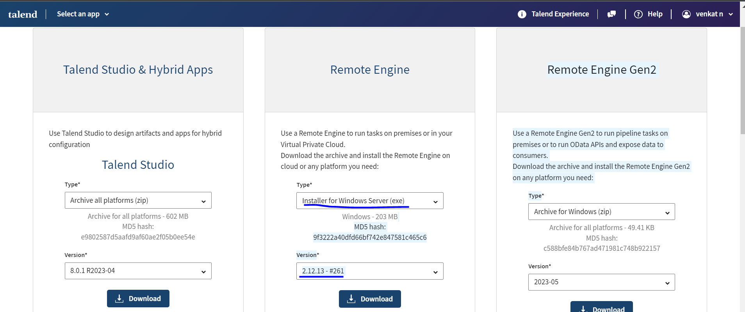
Step 9:- Download the Installer for Windows Server (exe) file of latest version.

Slide 7
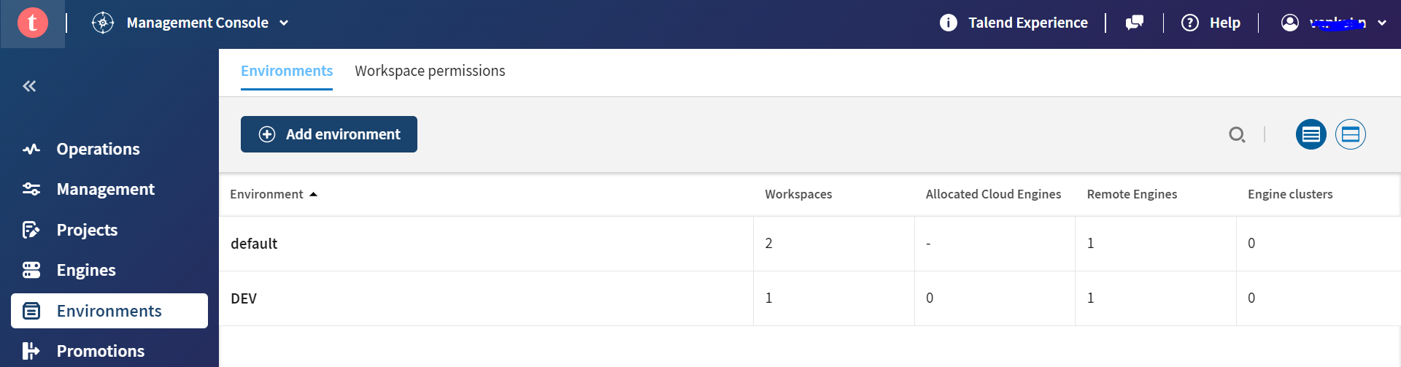
Step 10:- create the Remote Engine on Talend Cloud
*In the ADD Environment we can add different environments for remote engines.
*Goto Engines and select the Environmnet and create a Remote engine.

Slide 8
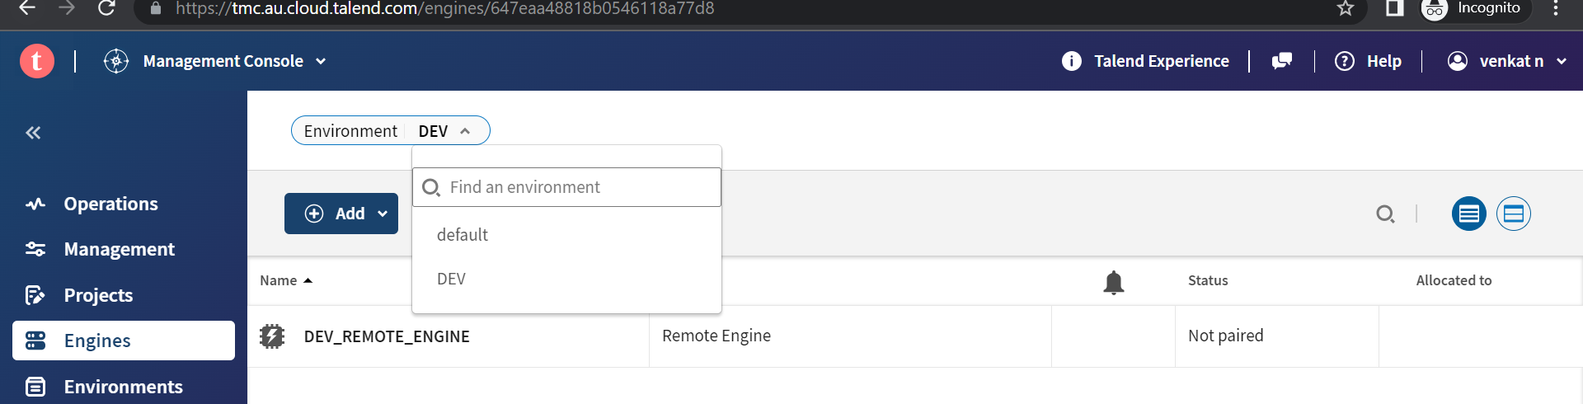
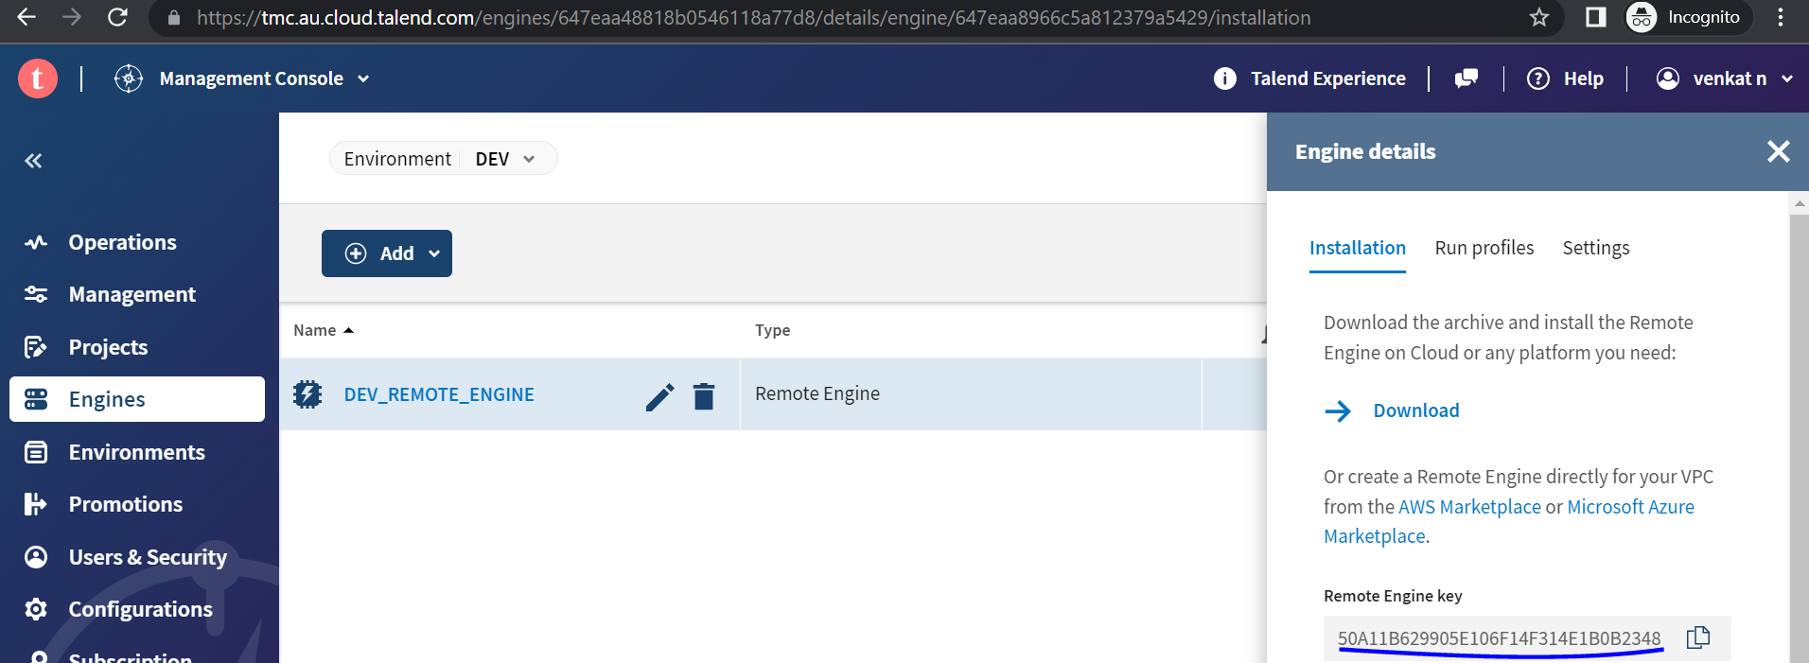
Step 11:- Click on the Remote engine name and copy the Remote Engine Key

Slide 9
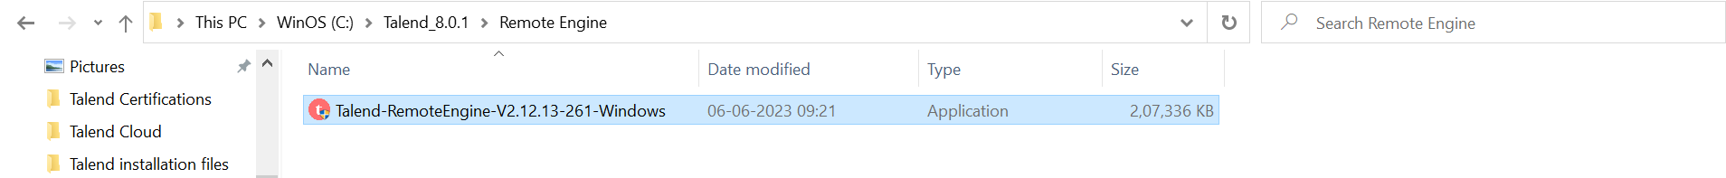
Step 12:- Goto to the installation .exe file Right click and Run as Administrator.
Step 13:- Accept the license terms and conditions.
Set the path of Installation Directory.
Select the Region.
Copy and Paste the Talend Remote engine Key.
Enable All system services.

Slide 10
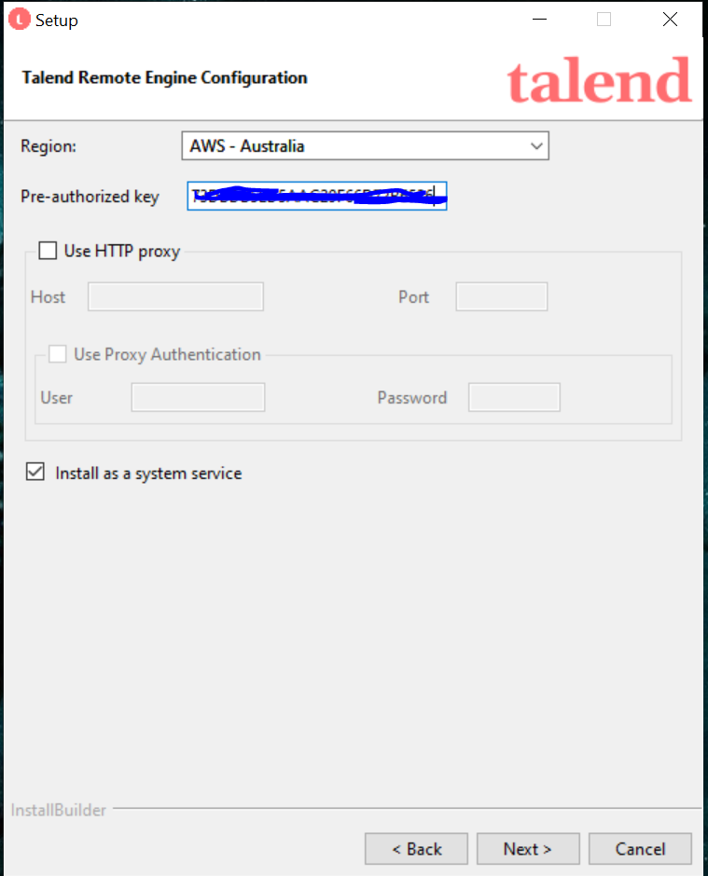

Slide 11
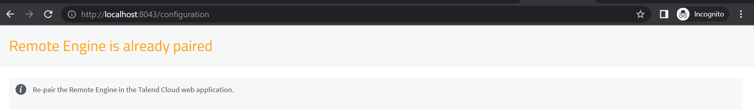
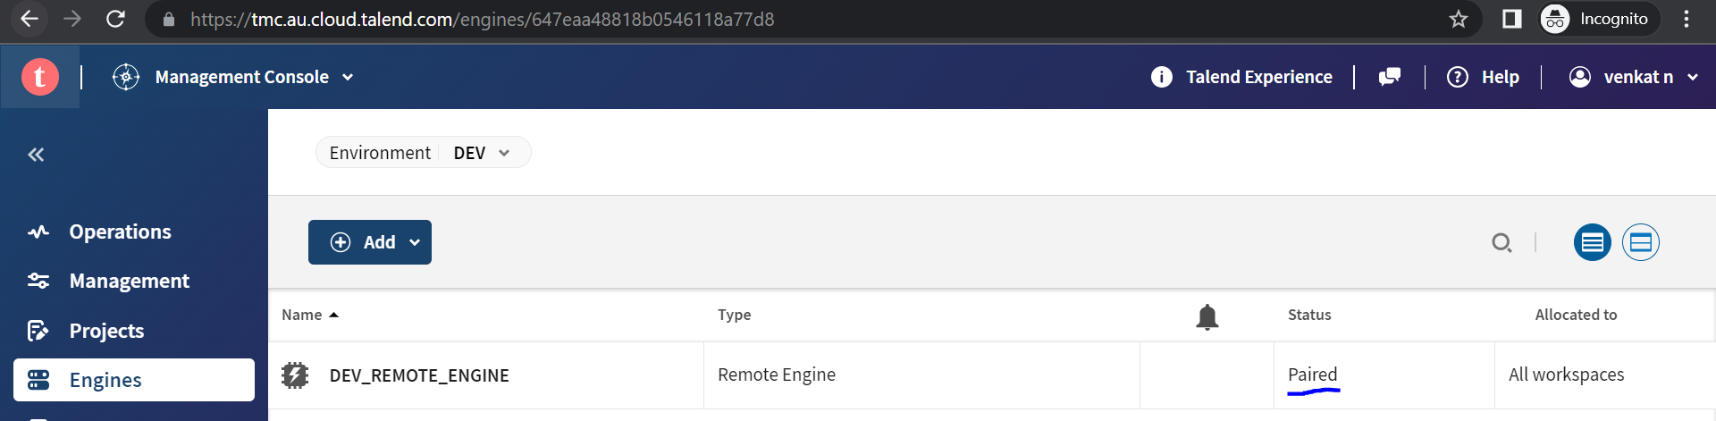
Step 14:- Check the Remote engine is paired
htpp://localhost:8043/configuration

Slide 12
-----------------------------------------------------------NOTE----------------------------------------------------------------------
If there is any issue Check the Below configuration files and check the Required changes.
Goto installation folder
C:\TalendRemoteEngine\etc
org.ops4j.pax.web.cfg
preauthorized.key.cfg
org.talend.ipaas.rt.pairing.client.cfg

